Slide 1
Cyber Threat Intelligence
Module 4.1
MIS 689
Cyber Warfare
Capstone

Slide 2
Module Objectives
Fundamental CTI
Exploring & Collecting Hacker Community Data
Exploring AZSecure Hacker Assets Portal: Identifying Threats, Actors, and Targets
CTI Visualization via Tableau (Your Own Analysis)

Slide 3
Fundamental CTI

Slide 4
CTI process
Phase 1: Intel Planning/Strategy
Description: Identify intelligence needs of organization, critical assets, and their vulnerabilities
Phase 2: Data Collection and Aggregation
Description: Identify and collect relevant data for threat analytics
Data sources: internal network data, external threat feeds, OSINT, human intelligence
Phase 3: Threat Analytics
Description: Analyze collected data to develop relevant, timely, and actionable intelligence
Approaches: malware analysis, event correlation, visualizations, machine learning
Phase 4: Intel Usage and Dissemination
Approaches: manual and automated threat responses, intelligence communication standards (e.g., STIX)
Description: Mitigate threats and disseminate intelligence
Approaches: threat trending, vulnerability assessments, asset discovery, diamond modelling
Four phased CTI Lifecycle
We are here

Slide 5
Popular CTI Analytics
Analytical Approach | Description | Examples | Value | Major Companies Using
Summary Statistics | High level summary of collected data | Number of blocked IP’s, locations of attacks, counts over time | Good overview for executives | All
Event Correlation | Analyzes relationships between events | Identifying machine sending malicious traffic by checking firewall log | Integrates multiple sources of data together (usually internal network) | All
Reputation Services | Identifying the quality of an IP | IP “X” has a poor reputation | Identify which IP addresses to block | Akamai, NSFOCUS, FireEye, AlienVault
Malware Analysis | Analyzing malicious files on a network | Decompiling ransomware | Bolster technical cyber-defenses | FireEye, AlienVault
Anomaly Detection | Detecting abnormal behaviors | Unusual user logins | Detect malicious activity | Splunk
Forensics | Identifying and preserving digital evidence | Examining RAM from a malicious system | Identifying how an attack occurred | LIFARS, Blue Coat, FireEye
Machine Learning* | Algorithms that can learn from and make predictions on data | Classifying malware | Automated analysis | Splunk, FireEye, Cylance
*We will have lectures dedicated to machine learning/data mining

Slide 6
Malware Analysis – Types of Malware
Type | Description
Backdoor | Allows an attacker to control the system
Botnet | Infected computers receive instructions from same Command-and-Control server
Downloader | Malicious code that exists only to download other malicious code
Information-stealing malware | Sniffers, keyloggers, password hash grabbers
Launcher | Malicious program used to launch other malicious programs
Rootkit | Malware that conceals the existence of other code, usually paired with a backdoor
Scareware | Frightens a user into buying something
Spam-sending malware | Attacker rents machine to spammers
Worms or Viruses | Malicious code that can copy itself and infect additional computers

Slide 7
Malware Analysis – Static vs Dynamic
Static Analysis – examines malware without running it
Quick and easy, but fails for advanced malware and can miss important behavior
Tools: VirusTotal, strings, disassemblers
Dynamic Analysis – run malware and monitor its effect
Easy, but requires a safe test environment. Not effective on all malware
Tools: RegShot, Process Monitor, Process Hacker, CaptureBAT
RAM Analysis: Mandiant Redline and Volatility

Slide 8
Exploring & Collecting Hacker Community Data (Du et al., IEEE ISI 2018)

Slide 9
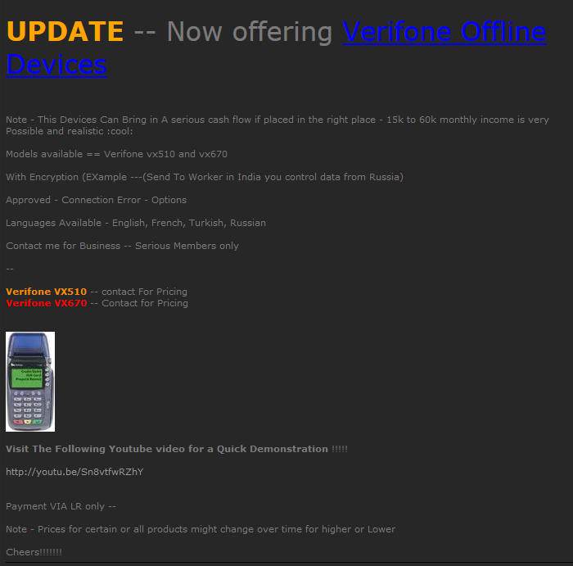
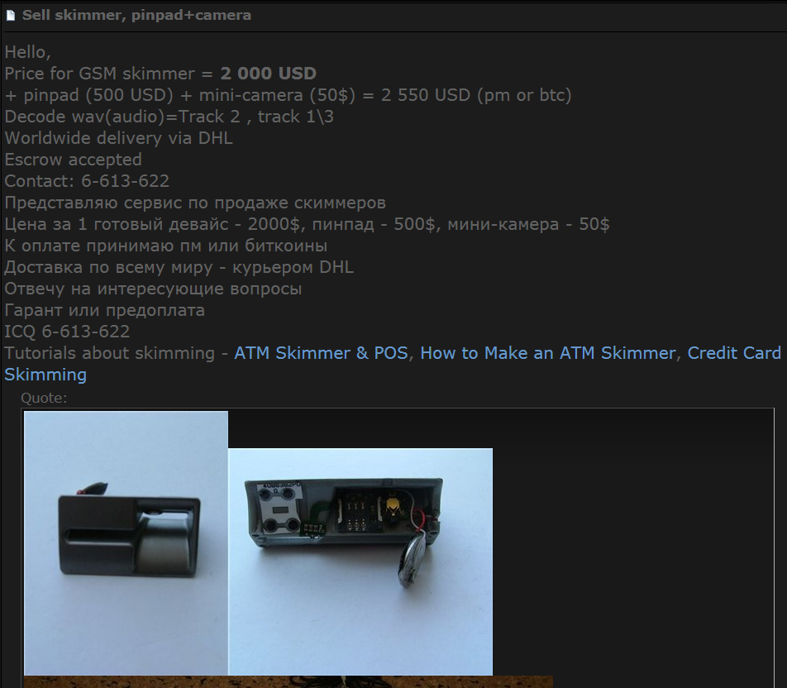
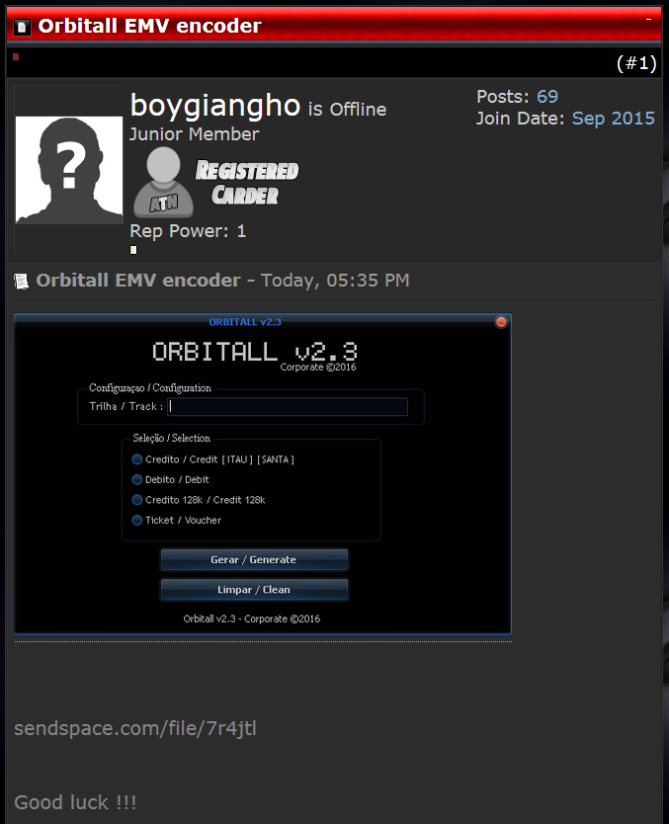
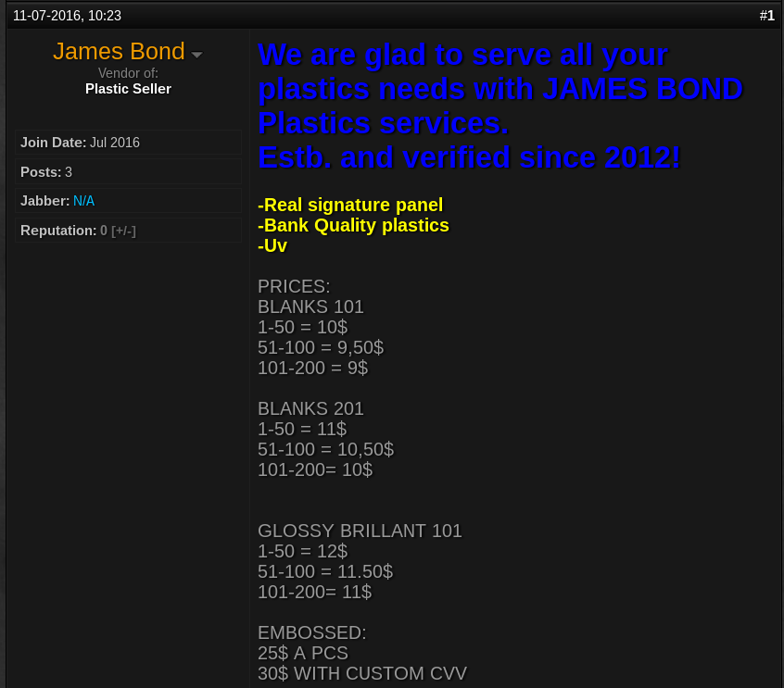
What are in the underground economy?
POS Skimmer
ATM Skimmer
Accessories
EMV encoder
Target POS device: Verifone vx510/vx670
Tutorials
Features
Youtube Tutorials
Sold in batch
Method of Payment: Liberty Reserve
Blank Credit/Debit Cards (Plastics)

Slide 10
Collection Challenges
Anti-crawling measures
IP address blacklisting
User-agent check
User/password authentication & CAPTCHA validation
Denial of service for too many requests
Potential risks of retaliation
Constantly probing underground economy platforms may spook platform owners.
These owners can trace back to us based on network traffic log.
→Need for secure, intelligent collection capabilities

Slide 11
Hacker Community Platforms Overview
Platform | Description | CTI Value
Hacker Forums | Message board allowing members to post messages (archived) | Key threat actor identification; sharing of hacking tools; indication of access to other hacker communities
IRC | Plain-text, instant messaging, communication (not archived) | Sharing of hacking knowledge and potential target; indication of access to other hacker communities
DNMs | Markets on Tor that sell illicit goods via cryptocurrency | Early indicator for breached companies; in-depth understanding of underground economy
Carding Shops | Shops selling stolen credit/debit cards and sensitive data | Monitoring trafficking of internet fraud industry; precaution of breaches before happen
Underlying Mechanism:
Hackers use forums and/or IRC to freely discuss and share Tools, Techniques, and Processes (TTP).
Hackers download tools or navigate to DNMs to purchase exploits.
These tools help hackers conduct cyber-attacks to attain sensitive data such as credit card and SSN.
Finally, hackers load stolen data to DNMs and/or carding shops for financial gain.
Table 1. Hacker Community Platform Summary

Slide 12
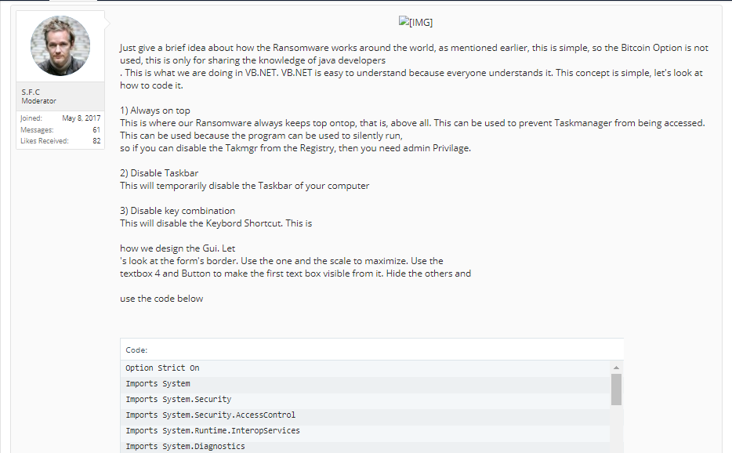
Data Collection Overview: Hacker Forums
Ransomware
description
Poster information
Ransomware code
Figure 1. An example of a hacker forum member sharing ransomware code

Slide 13
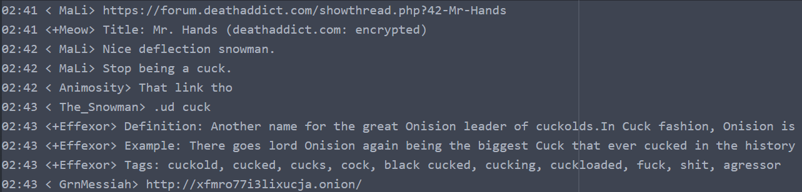
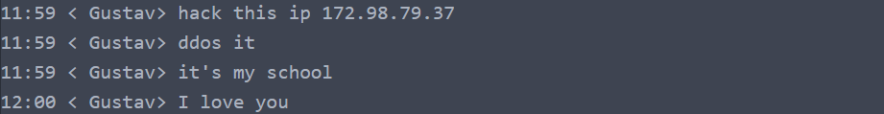
Data Collection Overview: IRC
Figure 2. An example of hackers sharing links containing illegal contents
Figure 3. An example of an IRC user demanding hacking service

Slide 14
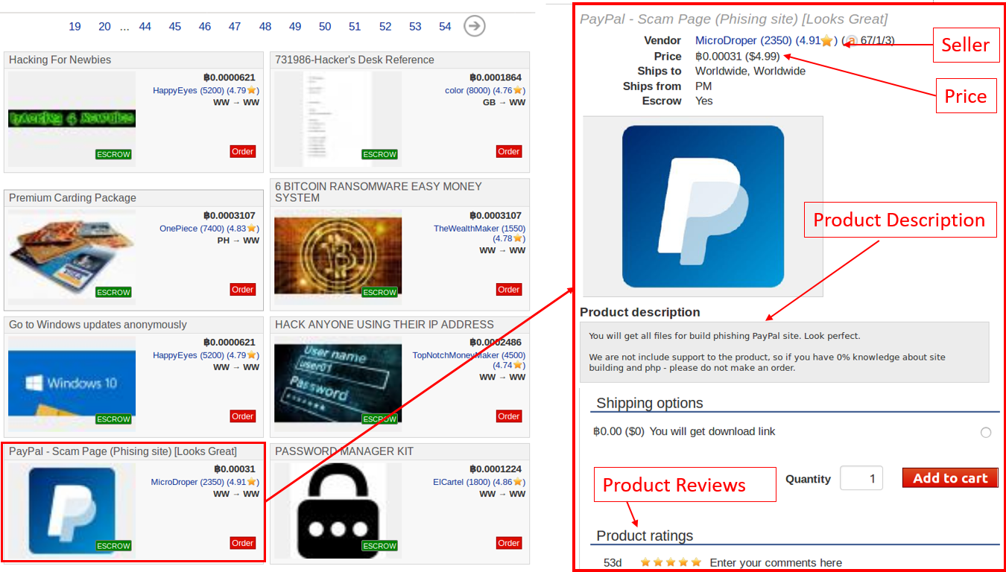
Data Collection Overview: DNM
Figure 4. An example of a product listing page on DNM

Slide 15
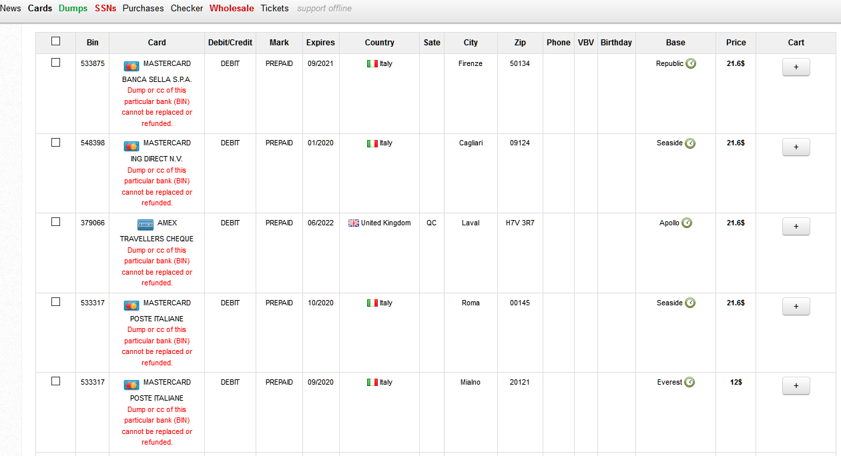
Data Collection Overview: Carding Shop
Card Type
Information of one card for carders
Figure 5. An example of listing page on carding shop

Slide 16
AZSecure Data Collection Overview
Platform | # of Platforms | # of Records | Languages
Forums | 51 forums | 32,266,852 posts | English/ Russian/ Arabic
IRC | 13 channels | 2,791,120 lines of conversation | English
DNM | 12 markets | 249,597 listings | English/ Russian/ French
Carding Shops | 26 shops | 8,674,078 listings | English
In our hacker community data collection, we successfully collected 102 platforms for a total of 43,981,647 records.
51 hacker forums,
13 IRC channels,
12 DNMs
26 carding shops
Table 2. Hacker Community Data Collection Summary

Slide 17
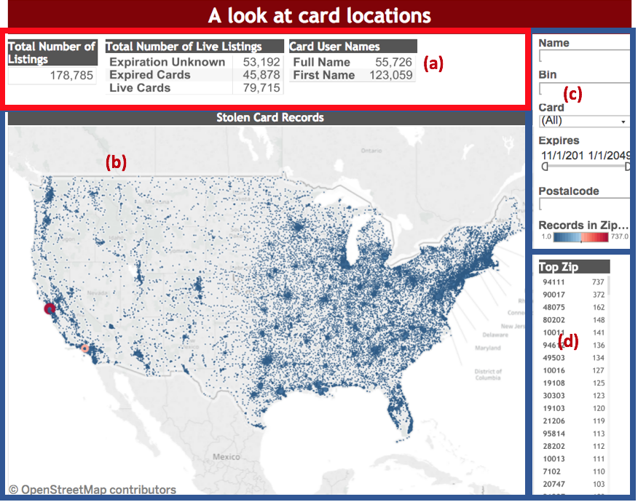
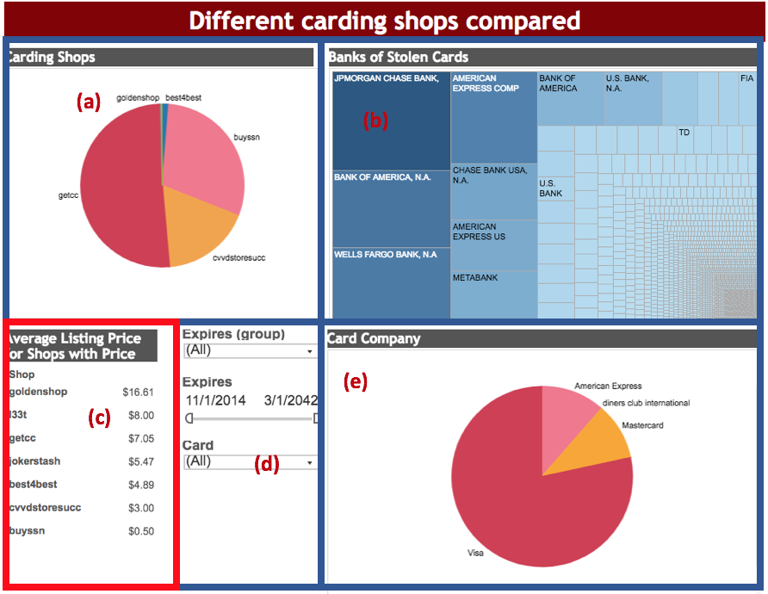
Data Integration and Visualization
Figure 7. (a) frequency of cards per shop, (b) banks of stolen cards, (c) average card prices, (d) filter capabilities, and (e) card issuers with most stolen cards
Figure 6. (a) scorecard of active and expired cards, (b) locations, (3) search, sort, and filter functions, and (d) frequency of cards based on zip code

Slide 18
Exploring AZSecure Hacker Assets Portal: Identifying Threats, Actors, and Targets (Samtani, et al., JMIS, 34(4), 2017)

Slide 19
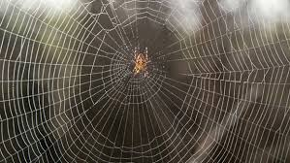

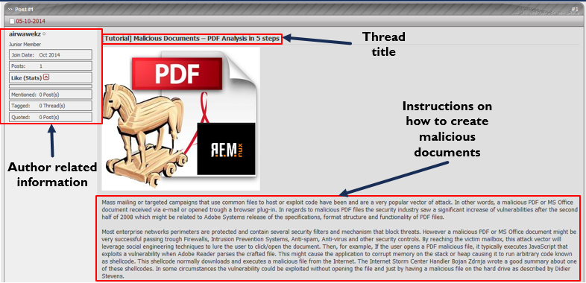
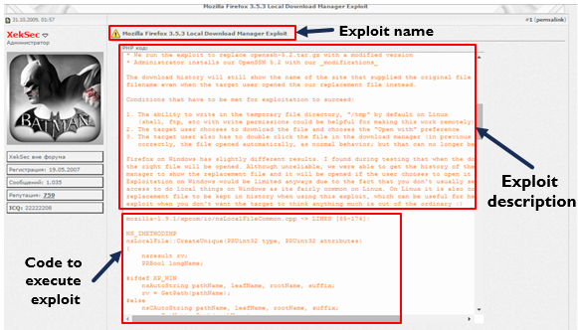
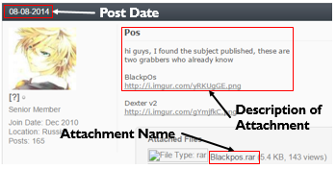

Hacker Asset Examples
Hackers and Hacker Assets
Tutorial on how to create
malicious documents
Forum post with source code to
exploit Mozilla Firefox 3.5.3
Forum post with
BlackPOS malware attachment.

Slide 20
Introduction – Hacker Asset Examples
Figure 1. Forum post with source code to create botnets
Figure 2. Forum post with BlackPOS malware attachment
Figure 3. Tutorial on how to create malicious documents

Slide 21

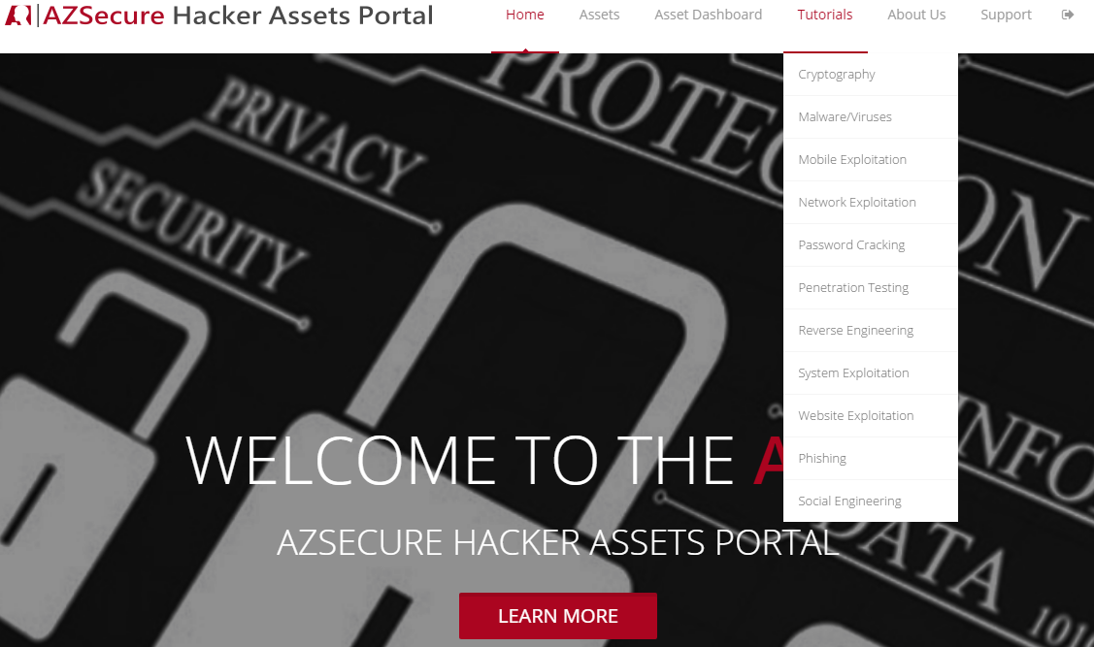



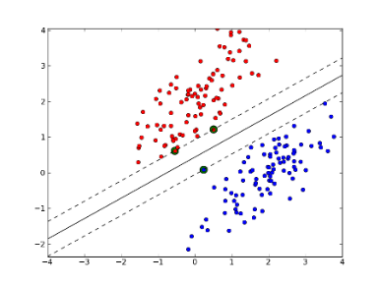
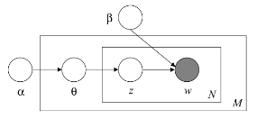


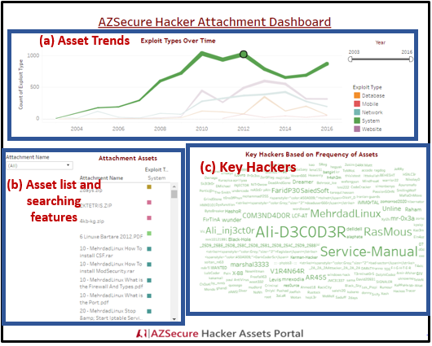
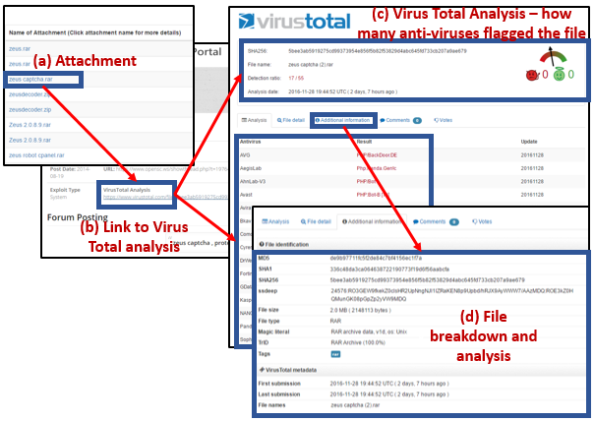
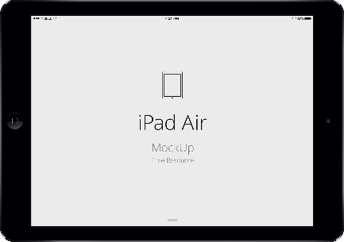

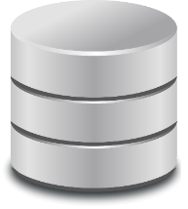
AZSecure Hacker Assets Portal System Design and Features
Data Collection and Analytics
Web Hosting and Access
System Functionalities
Browsing
Searching
Downloading
System Analytics
Latent Dirichlet Allocation (LDA) and
Support Vector Machine (SVM) Analytics
987 tutorials, 15,576 source code, and
14,851 attachments
Cyber Threat Intelligence
Dashboard
VirusTotal Malware Analysis
Figure 5. AZSecure Hacker Assets Portal System Design and Features

Slide 22
AZSecure Hacker Assets Portal – Data Testbed
Forum | Language | Date Range | # of Posts | # of Members | # of source code | # of attachments | # of tutorials
OpenSC | English | 02/07/2005-02/21/2016 | 124,993 | 6,796 | 2,590 | 2,349 | 628
Xeksec | Russian | 07/07/2007- 9/15/2015 | 62,316 | 18,462 | 2,456 | - | 40
Ashiyane | Arabic | 5/30/2003 – 9/24/2016 | 34,247 | 6,406 | 5,958 | 10,086 | 80
tuts4you | English | 6/10/2006 – 10/31/2016 | 40,666 | 2,539 | - | 2,206 | 38
exelab | Russian | 8/25/2008 – 10/27/2016 | 328,477 | 13,289 | 4,572 | - | 628
Total: | - | 02/07/2005- 10/31/2016 | 590,699 | 47,492 | 15,576 | 14,851 | 987
Notes:
The Data Mining slide needs to have a system diagram, testbed, and validation results – some significant details to lend credibility.

Slide 23
AZSecure Hacker Assets Portal – Data Mining Approach
Algorithm | Accuracy | Precision | Recall | F1
SVM | 98.20 | 96.36 | 98.20 | 98.28
k-Nearest Neighbor | 64.00 | 83.47 | 64.00 | 72.24
Naïve Bayes | 86.00 | 88.57 | 86.00 | 87.26
Decision Tree | 82.60 | 86.41 | 82.60 | 84.42
Notes:
The Data Mining slide needs to have a system diagram, testbed, and validation results – some significant details to lend credibility.
Benchmarking in this fashion is a commonly accepted evaluation practice in computer science and related domains.

Slide 24
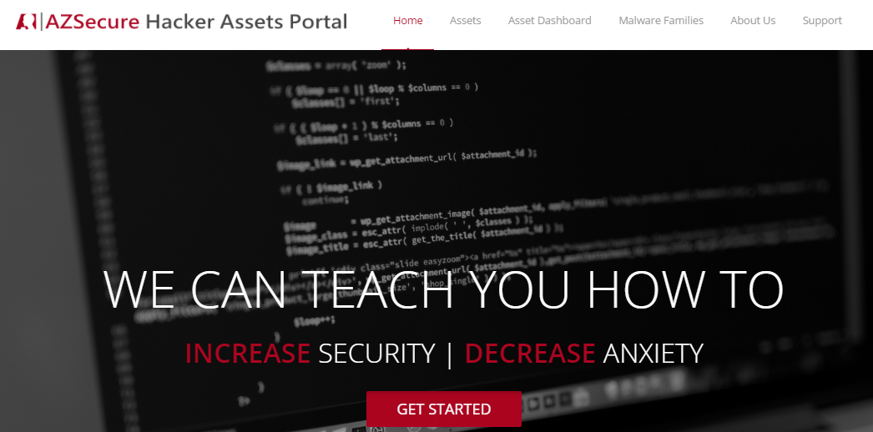
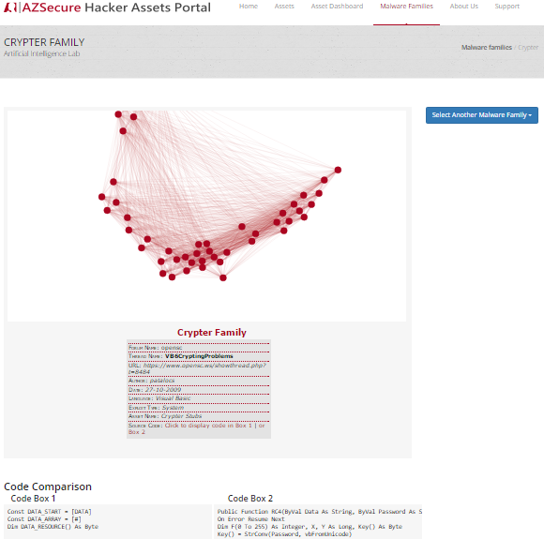
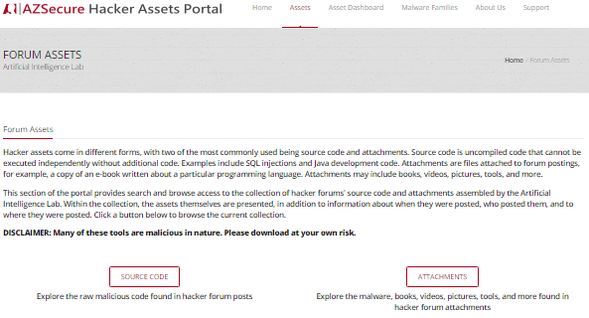
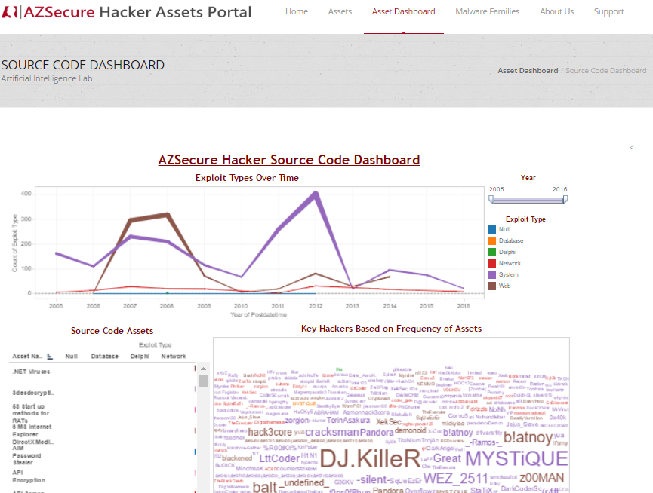
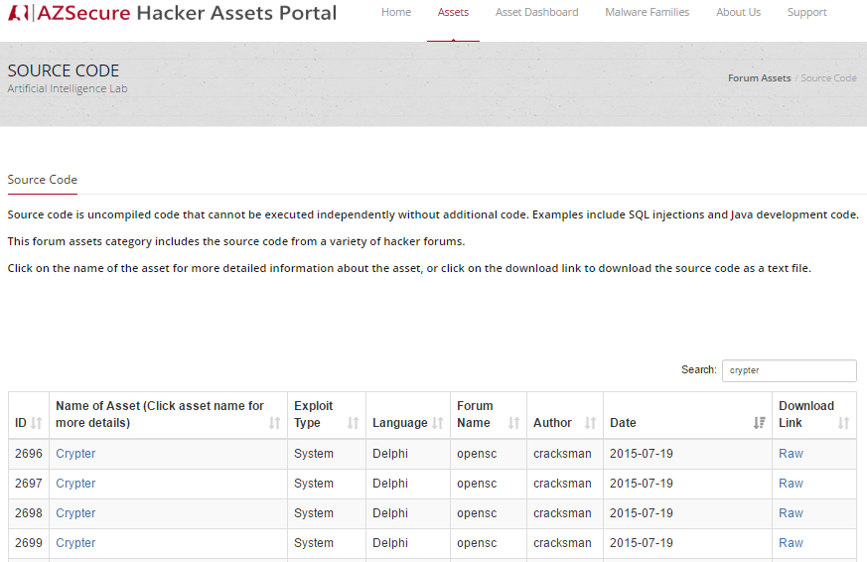
Hacker Assets Portal V2.0 – Overview
(a) Home page, linking to (b & c) Assets, (d) Dashboard, and (e) Malware Families:
(e) Malware Families, for depicting relationships among assets over time (Crypter Family shown)
(b) Assets page, linking to Source Code and Attachments
(c) Source Code page; sortable by asset name, exploit type, date, etc.
(d) Dashboard for drill-down analysis of hackers & assets over time

Slide 25
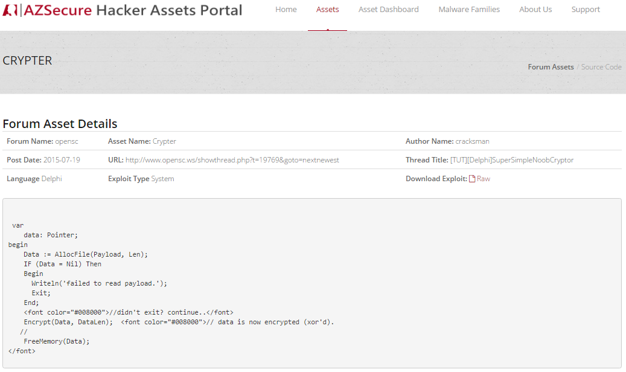
Searching, Sorting & Browsing Hacker Assets
(d) Browsing: Asset metadata and forum link
(a) Searching
(b) Sorting
(e) Browsing: Raw Code
(c) Browsing

Slide 26
Cyber Threat Intelligence (CTI) Dashboard
Notes:
Please add one slide illustrating how the hacker assets can help SFS students and other professionals in gaining knowledge about proactive threat intelligence and future defense. Illustrate actual utilities for good guys via some examples.
The Malware example needs to show how for cyber defense. You can select and download but so what? What do I learn to defend my assets, e.g., types of vulnerability, system?

Slide 27
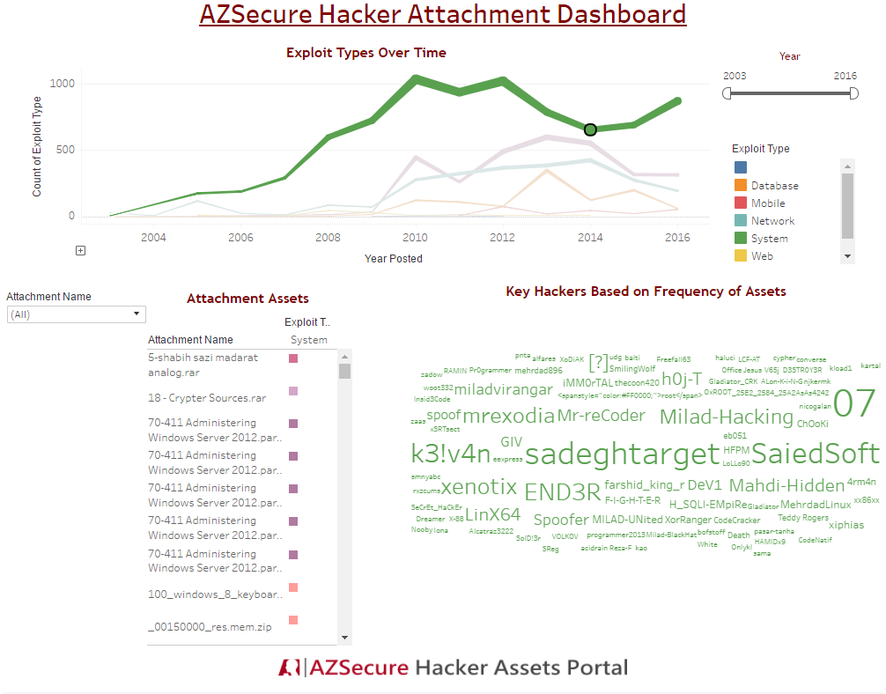
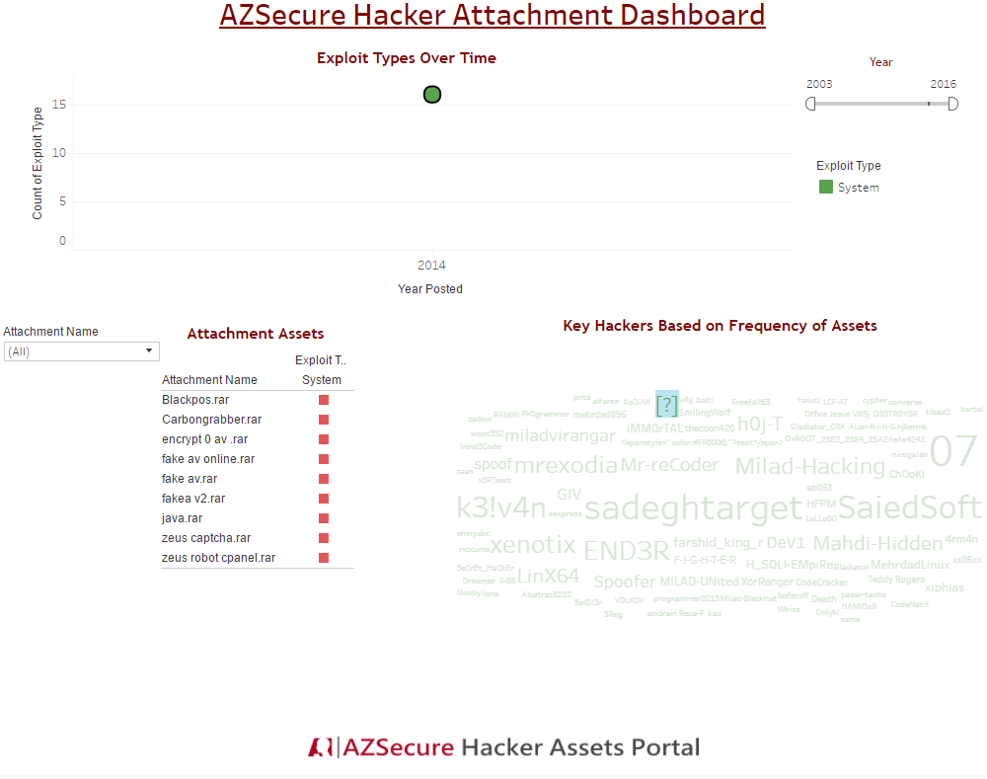
Cyber Threat Intelligence (CTI) Example – Bank Exploits
1
2
Filtering on 2014, when BlackPOS was posted, shows assets and threat actors at that time.
Filtering the actor who posted BlackPOS reveals that he posts other bank exploits (e.g., Zeus).
Provides intelligence on which hacker to monitor.

Slide 28
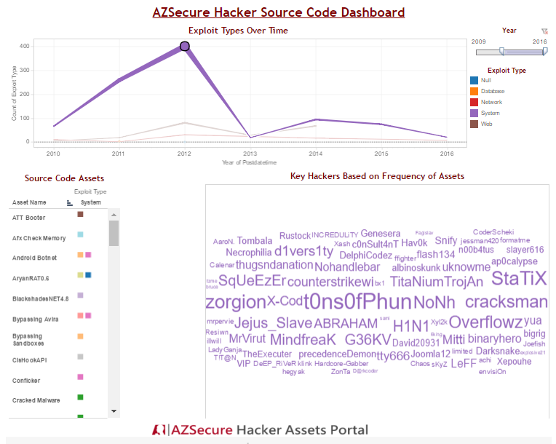
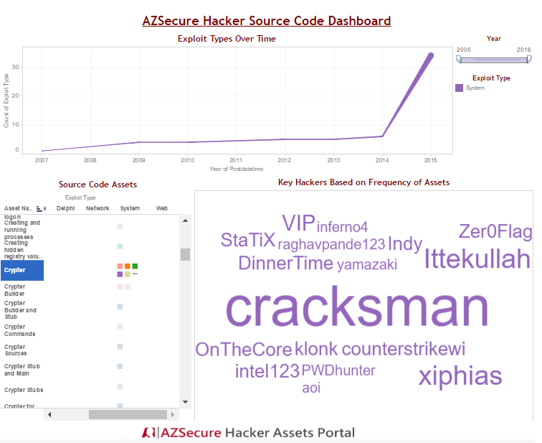
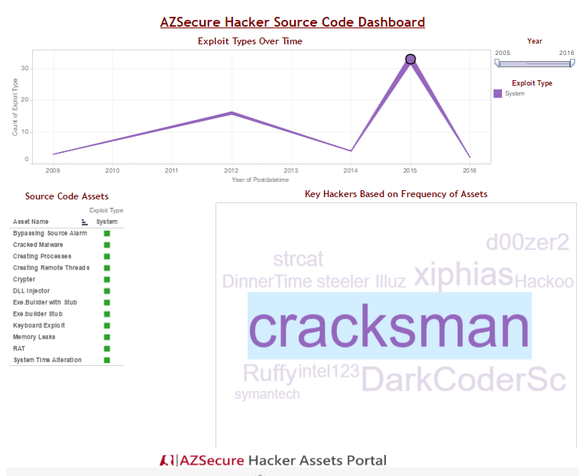
Cyber Threat Intelligence (CTI) Example – Crypters
1
2
3
Filtering on a specific time point (highest peak):
Filtering on a specific asset (crypters, a key technology for Ransomware)
Filtering a specific crypter author (Cracksman) shows the trends and types of assets he posted.

Slide 29
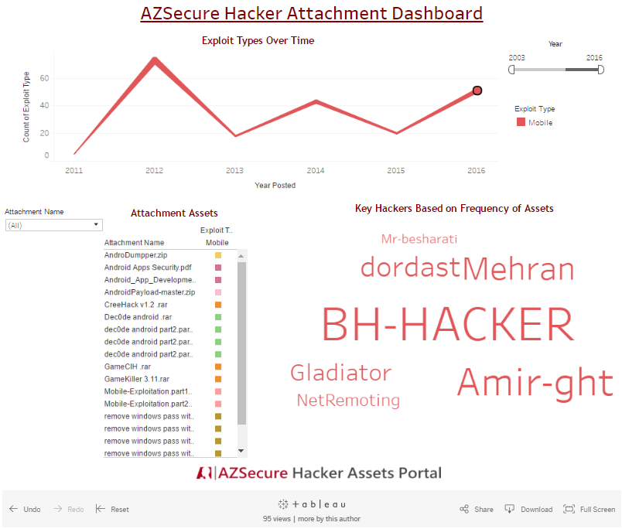
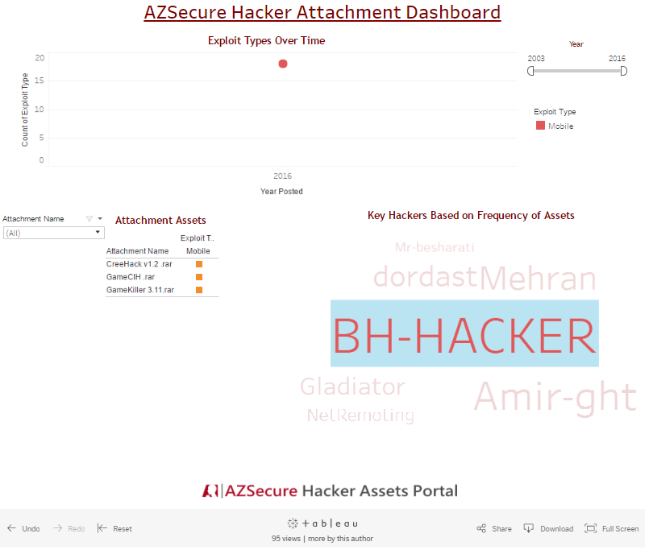
Cyber Threat Intelligence (CTI) Example – Mobile Malware
1
2
Filtering for 2016 mobile malware shows assets and threat actors at that time.
Filtering on a specific actor (BH-HACKER) allows us to see the assets posted.

Slide 30
CTI Data Exploration & Visualization via Tableau (Your Own Analysis)

Slide 31
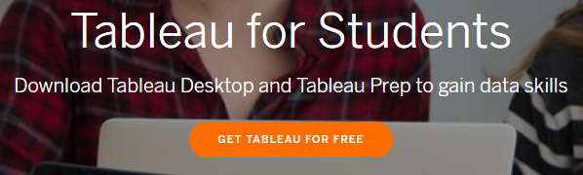
Tableau Background
Tableau is a powerful data visualization software.
Capable of creating various interactive visualizations from a multitude of data sources.
Tableau is a commercial software, but is available to students for free.
Download from (http://www.tableau.com/academic/students)
Tableau is primarily a drag-and-drop software.

Slide 32
Data Sources and Types of Visualizations
Tableau can connect to variety of data sources, including:
Local files – Excel, text, Access
Traditional databases – SQL Server, MySQL, Oracle, PostgreSQL, DB2
Cloud technologies – Amazon Aurora, EMR, Redshift, BigQuery
Big Data Technologies – Hadoop, Hive, Spark SQL
Tableau can create a variety of visualizations including:
Basic bar and line charts (e.g., temporal, box plots, etc.)
Geospatial analysis
Word clouds
Treemaps
Network analysis, although there are better tools for this (e.g., Gephi)!
These visualizations can be combined into interactive dashboards.
Can later be published online or shared easily.

Slide 33
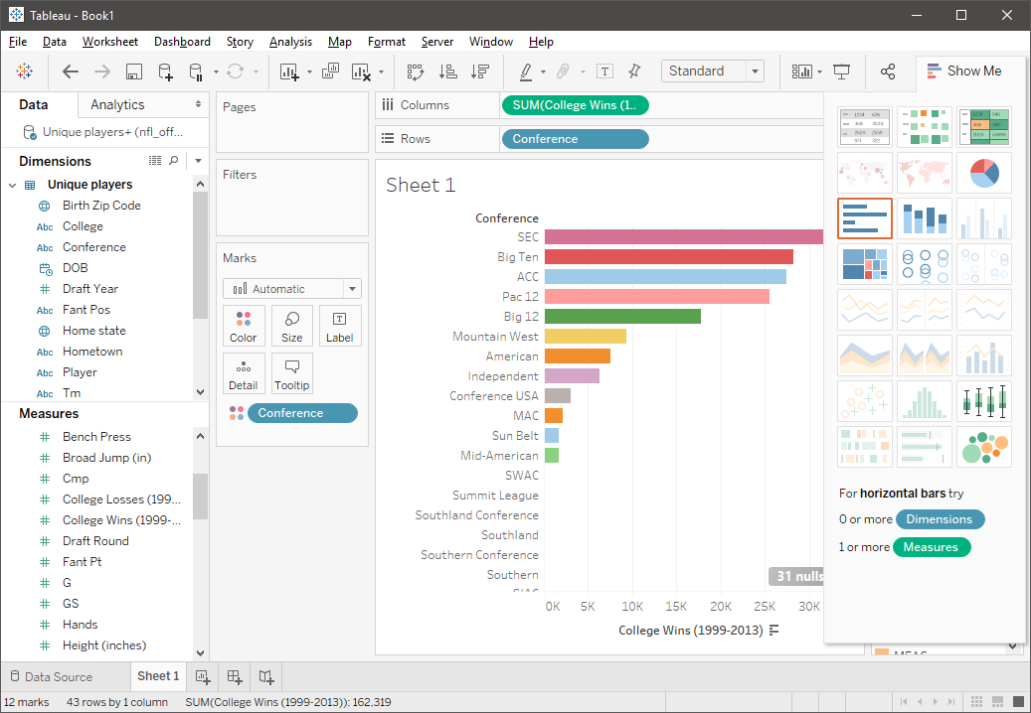
Tableau Interface
Blue: discrete data
Green: continuous data
Dimensions
Data fields that cannot be aggregated
Qualitative values (such as names, dates, or geographical data)
Measures
Data fields that can be measured, aggregated, or used for math operations
Numeric, quantitative values
Drag-n-drop
Data
Worksheet
Format/Encode
Plot types
Tabs
https://onlinehelp.tableau.com/current/pro/desktop/en-us/datafields_typesandroles.htm

Slide 34
Walkthrough Example: NFL Sports Analytics
The data used in this example is an Excel spreadsheet about NFL Offensive players from 1999-2013. It contains:
~40,000 rows of data
Player information (physically measurable traits, birthplace, college attended)
Positions played
Wins achieved in career

Slide 35
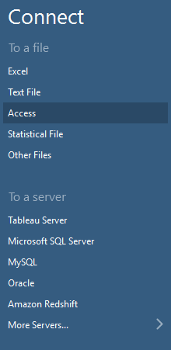
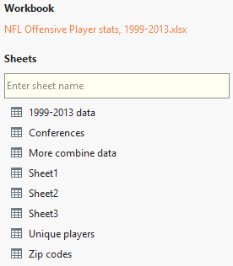
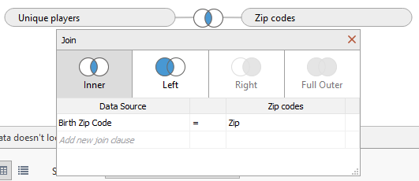
Connecting to a Data Source
1
2
3
2
We will have to connect to a data source to start making visualizations.
Since our data is in an Excel workbook, we will select that.
Second, we will join two of the sheets in the workbook such that we can get access to a larger set of data. Drag the “Unique players” and “Zip codes” sheets to the right. Select the “Inner” join option.
We will join the sheets based on zip code.

Slide 36
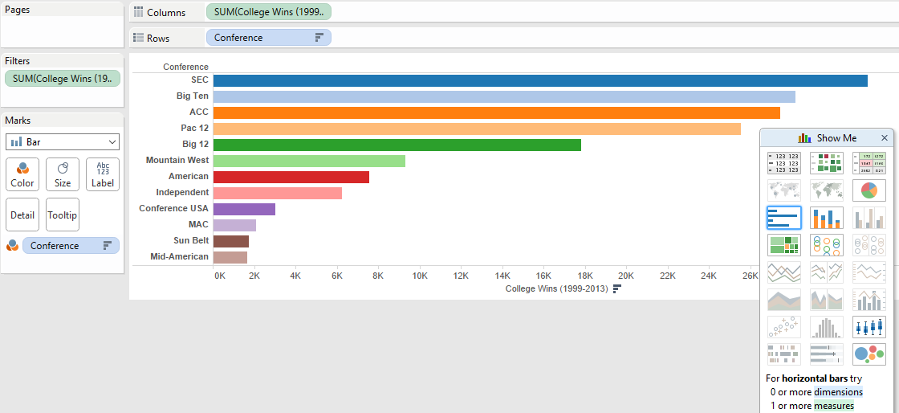
Creating a Bar Chart
1
3
2
Suppose we want to know which major college conferences have most combined wins since 1999.
First, drag the “Conference” dimension into the “Rows” bar, and the “College Wins” into the columns. Hit the drop down on the “College Wins” and select “Sum.”
Second, select bar chart on the right hand side.
To add a little bit of color, drag the “Conference” into the “Color” mark.

Slide 37
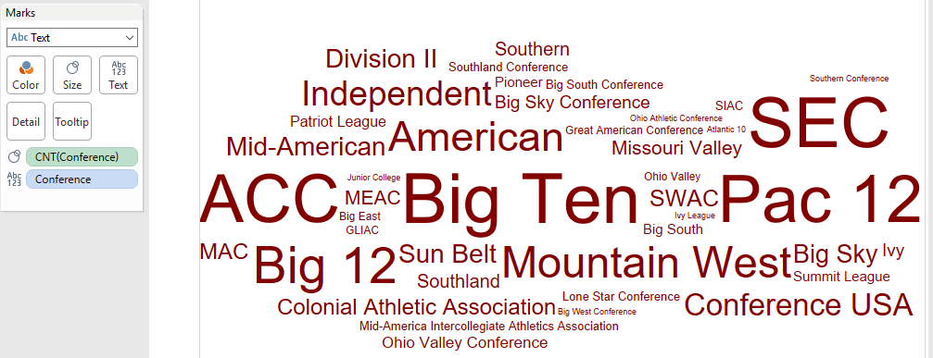
Creating a Word Cloud
1
2
Suppose now we want to get a general sense of the most popular conferences in terms of player enrollment is concerned. A word cloud is a great way to visually represent this.
First, switch the “Marks” option to “Text”.
Second, drag the “Conference” dimension into the “Text” marks box.
Then drag the “Conference” dimension into the “Size” marks box.
Adjust the measurement on this by hitting the drop down and selecting “Measure (Count)”

Slide 38
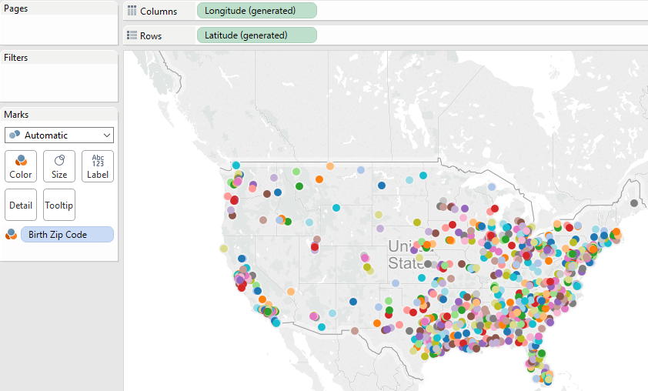
Creating a Geospatial Visualization
Consider now that we are interested in the birthplaces of all of the NFL players.
We can easily create a map representation.
Drag the “Longitude” dimension to columns, and “Latitude” dimension to the rows. Select the map visualization.
Add in some color by dragging the “Birth Zip Code” into the “Color” Marks.
1
2

Slide 39
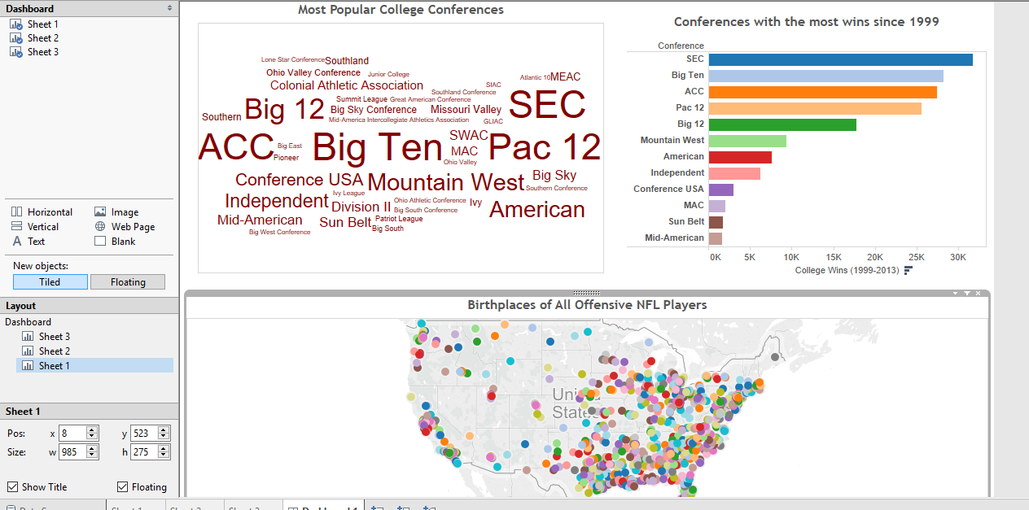
Combining Visualizations into a Dashboard
To tell a more comprehensive story, we can create a dashboard combining all of the visualizations.
Simply open a dashboard view and start dragging sheets into the dashboard.
You can format and add filters into the dashboard as you wish.

Slide 40
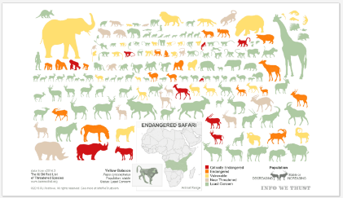
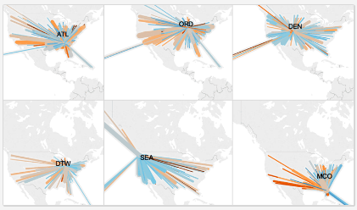
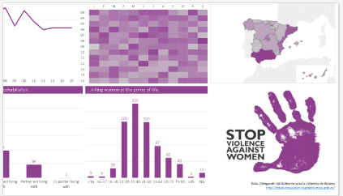
Further Examples
It is useful to explore other Tableau visualizations to get ideas.
https://public.tableau.com/s/gallery contains many great visualizations.
Endangered Safari
US Flights Delayed by Precipitation
Domestic Violence in Spain

Slide 41
Tableau Resources
Gallery of Tableau visualizations:
https://public.tableau.com/s/gallery
Tableau training videos:
http://www.tableau.com/learn/training
Sample Tableau data sources:
https://public.tableau.com/s/resources
Reference book:
Tableau Your Data!: Fast and Easy Visual Analysis with Tableau Software. Daniel Murray, 2nd edition, 2015.
Available online through UA Library
Companion materials: http://tableauyourdata.com/downloads/

